Slide 1
Chapter 7: Deriving Use Cases from Requirements

Slide 2
Key Takeaway Points
A use case is a business process; it begins with an actor, ends with the actor, and accomplishes a business task for the actor.
Use cases are derived from requirements and satisfy the requirements.
Planning the development and deployment of use cases and subsystems to meet the customer’s business needs and priorities.
7-<number>

Slide 3
Deriving Use Cases in the Methodology Context
Business goals
& needs
Current situation
Use case-iteration allocation matrix
Accommodating
Requirements Change
Customer
feedback
Acquiring
Requirements
(Domain Modeling)
Iteration use cases
Domain Modeling
Preliminary requirements
Domain model
Domain model
Deriving Use Cases
from Requirements
Actor-System Interaction Modeling
Abstract & high level use cases, use case diagrams
Expanded use cases & UI design
Allocating Use Cases & Subsystems
to Iterations
Behavior Modeling &
Responsibility Assignment
Behavior models
Use case-iteration allocation matrix
Deriving Design Class
Diagram
Producing an Architecture Design
Design class diagram
Software architecture
Test Driven Development, Integration, & Deployment
(a) Planning Phase
(b) Iterative Phase – activities during each iteration
control flow
data flow
control flow & data flow
7-<number>

Slide 4
What Is a Use Case?
A use case is a business process.
A use case must be initiated by an actor.
A use case must end with the actor.
  The actor explicitly or implicitly acknowledges the accomplishment of the business task.
A use case must accomplish a business task (for the actor).
7-<number>

Slide 5
What Is an Actor?
An actor denotes a business role played by (and on behalf of) a set of business entities or stakeholders.
Actors are not part of the system.
Actors interact with the system.
Actors are often human beings but can also be a piece of hardware, a system, or another component of the system.
Actors initiate use cases, which accomplish business tasks for the respective actors.
7-<number>

Slide 6

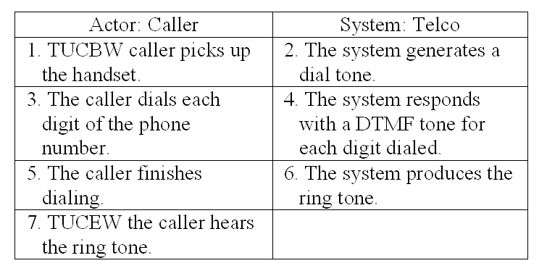
Use Case Modeling Steps
planning phase
iterative phase
Deriving use cases
from requirements
requirements
abstract use cases
(e.g., Initiate a Call)
Defining use case scope
abstract &
high level use cases
Example high level use case:
TUCBW caller picks handset from base
TUCEW caller hears the ring tone.
Telco
Initiate a Call
Answer a Call
Specifying actor-
system interaction
(expanded use cases)
Depicting use case contexts
7-<number>

Slide 7
Deriving Use Cases from Requirements
In the requirements specification, look for verb noun phrases that indicate domain specific
  “do something”
  “something must be done” or
  “perform some task”
  in the application domain.
Verify the verb noun phrases using use case definition (next slide).
7-<number>

Slide 8
Verify the Use Cases Identified
Verify the use cases identified using use case definition:
  (1) Is it a business process? y/n
  (2) Is it initiated by an actor? y/n
  (3) Does it end with the actor? y/n
  (4) Does it accomplish something useful for the actor? y/n
All the answers to above questions must be “y.”
7-<number>

Slide 9
Identify Actor, System or Subsystem
From the requirements, identify also
  the actors, who initiate the tasks, or for whom the tasks are performed
  the system or subsystem that contains the use case
7-<number>

Slide 10
Example: Library System
Requirements of a library system:
R1. The library system must allow a patron to
check out documents.
R2. The library system must allow a patron to
return documents.
system
actor
use case
 | Use Case | Business Process? | Begin w/ Actor? | End w/ Actor? | Useful Task for Actor? | Use Case? | Actor | System
R1
Checkout Document
Y
Y
Y
Y
Y
Patron
Library System
R2
Return Document
Y
Y
Y
Y
Y
Patron
Library System
7-<number>

Slide 11
Use Case Diagram: Library Example
system name
use case
actor
Library System
Checkout Document
Return Document
Patron
Search for Document
association
system boundary
7-<number>

Slide 12
Example: Oversea Exchange Program
R1. The web-based application must provide a search capability for overseas exchange programs using a variety of search criteria.
R2. The web site must provide a hierarchical display of the search results to facilitate user navigation from a high level summary to details about an overseas exchange program.
Use Case
Business Process?
Begin w/ Actor?
End w/ Actor?
Useful Task for Actor?
Use Case?
Actor
System
R1
Search for Programs
Y
Y
Y
Y
Y
User
Web App.
R2
Display Program Details
Y
Y
Y
Y
Y
User
Web App.
7-<number>

Slide 13
Business Process, Step, Operation and Action
A business process is a series of steps to accomplish a complete business task.
An operation is a series of actions or instructions to accomplish a step of a business process.
7-<number>

Slide 14
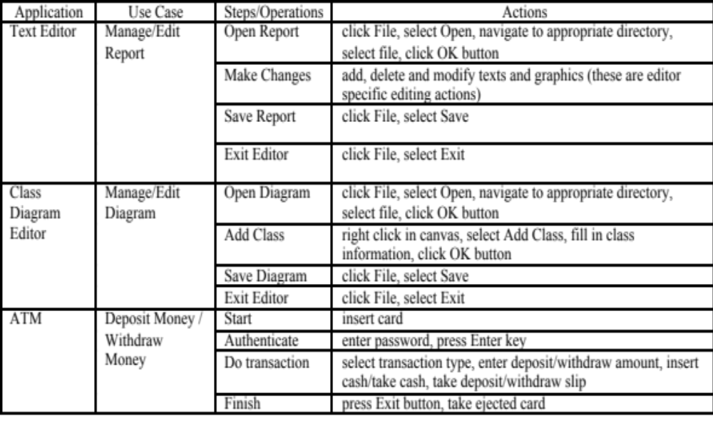
Business Process, Step, Operation and Action
7-<number>

Slide 15
Are the followings use cases? Why?
Check authorization / check authentication
Enter a password
Process data
Open a file
Click on a menu item
Traverse a linked list.
Start a system
7-<number>

Slide 16
Use Case Diagram: Notion and Notation
Notion
Meaning
Notation
Use case
A use case is a business process that begins with an actor, ends with the actor, and accomplishes a business task useful for the actor.
use case name
Actor
An actor is a role played by and on behalf of a set of business entities or stakeholders that are external to the system and interact with the system.
System Boundary
It encloses the use cases and shows the capabilities of the system.
system name
Association between actors and use cases
It indicates that the actor uses the use case.
7-<number>

Slide 17
Advanced Notions and Notations
Notion
Meaning
Notation
Inheritance
It indicates that one use case is more general/ specialized than the other.
Pointing from specialized use case to generalized use case.
Extension
It indicates that one use case can optionally continue the process of another use case.
Pointing from extension use case to extended use case.
<<extend>>
Inclusion
It indicates that one use case includes another use case as part of its business process.
Pointing from including use case to included use case.
<<include>>
7-<number>

Slide 18
Use Case Diagram: Library Example
system name
use case
actor
Library System
Checkout Document
Return Document
Patron
Search for Document
association
system boundary
7-<number>

Slide 19
Simplify with Use of Inheritance
An admin can also
checkout and return
a document. But a
patron cannot
start or shutdown the
system.
Library System
Checkout a
Document
Patron
Return a
Document
Startup
Inheritance: It states
that an Admin IS-A
Patron.
Shutdown
Admin
7-<number>

Slide 20
Simplify with Use of Inheritance
SAMS/Search Program
SAMS
Admin
Login
SAMS
End User
Logout
SAMS
Staff
SAMS/Search Program
This is OK.
Login
Logout
SAMS
End User
SAMS
Admin
SAMS
Staff
Better
7-<number>

Slide 21
Guidelines for Use Case Diagram
Avoid showing
  many use cases in one diagram (see next slide)
  many use case diagrams each containing only one use case
  overly complex use case diagrams
  unnecessary relationships between use cases
Use several diagrams to show groups of closely related use cases:
    show only use cases and actors that are relevant
    provide a meaningful name for the system/subsystem that implements group of use cases
7-<number>

Slide 22
Guidelines for Use Case Diagram
Use inheritance to simplify the diagram by reducing the number of actor-use case links.
Give a meaningful name for the system/subsystem that contains the use cases. The name may serve as the package or module name in design/implementation.
Actor-use case relationships are always association relationships.
Only use cases and their relationships can be shown within the system boundary.
7-<number>

Slide 23
Use Case Diagram
SAMS
Search for Programs
Log In
Log Out
SAMS
End User
Display Program
Detail
Start Up
Overly Complex!
Apply Online
Shutdown
Add Program
Create User
Delete Program
Delete User
SAMS
Staff User
SAMS
Admin
Edit Program
Update User
7-<number>

Slide 24
SAMS/User Mgmt
SAMS/Program Mgmt
Create User
Add Program
Delete User
SAMS
Admin
Delete Program
Update User
SAMS
Staff
Start Up
Edit Program
Software engineering
principle applied:
separation of
concerns
divide and conquer
Shutdown
SAMS/End User
SAMS/Authentication
Search for Programs
Login
Display Program
Detail
Logout
SAMS
End User
Apply Online
SAMS
End User
SAMS
Admin
SAMS
Staff
7-<number>

Slide 25
Do Not Make It Unnecessarily Complex
SAMS/Program Mgmt
SAMS/Program Mgmt
Login
Login
<<extend>>
Add Program
Add Program
<<extend>>
Delete Program
Delete Program
SAMS
Staff
SAMS
Staff
Edit Program
<<extend>>
Edit Program
<<extend>>
<<extend>>
<<extend>>
Login
Login
This diagram is
made unnecessarily
complex by adding
the extend
relationships.
Much better
7-<number>

Slide 26

What Should Be In and Out?
SAMS/Program Mgmt
SAMS/Program Mgmt
Login
Login
Add Program
Add Program
Only use cases and their relationships are allowed in the boundary.
Delete Program
Delete Program
SAMS
Staff
Edit Program
SAMS
Staff
Edit Program
Login
Login
SAMS/Program Mgmt
SAMS/Program Mgmt
Login
Login
Add Program
Add Program
Delete Program
Delete Program
DB
SAMS
Staff
SAMS
Staff
Edit Program
Edit Program
Hacker
Login
Login
7-<number>

Slide 27
Use Case Specification: 3 Levels of Abstraction
Abstract use case: a verb-noun phrase
High level use case: when and where the use case begins and when it ends
  TUCBW (This use case begins with ...)
  TUCEW (This use case ends with ...)
Expanded use case: step-by-step description of how the actor interacts with the system to carry out the business process
7-<number>

Slide 28
Abstract Use Case and High level Use Case
Abstract use case: Initiate a Call
High level use case:
    Use Case: Initiate a Call
    TUCBW the caller picks up the handset from the phone base.
    TUCEW the caller hears the ring tone.
7-<number>

Slide 29
High Level Use Case Example
Use Case: Withdraw Money (from an ATM)
TUCBW the ATM user inserts an ATM card into the card slot.
TUCEW the ATM user receives the correct amount of cash and a withdraw slip.
Use Case: Search for Programs
TUCBW a SAMS user clicks the ``Search for Programs'' link on any of the SAMS pages.
TUCEW the user sees a list of programs satisfying the search criteria.
7-<number>

Slide 30
Guidelines for High Level Use Case
A high level use case should not specify background processing:
  Do not specify how the system process the request such as update the database.
  Background processing is modeled by sequence diagrams.
High level use cases should end with what the actor wants to accomplish.
7-<number>

Slide 31
Requirements Use Case Tractability
How do you know that the system will deliver all the capabilities stated in the requirements?
How do you know to what extent the system will satisfy the requirements?
How do you know if some use cases are missing?
How do you know which use cases are not needed?
How do you know which requirements are more important than the other?
How do you know which use cases should have high priority?
7-<number>

Slide 32
Requirements-Use Case Traceability Matrix
PriorityWeight
UC1
UC2
UC3
UC4
UC5
UC6
R1
3
X
X
R2
2
X
R3
2
X
R4
1
X
X
R5
1
X
X
R6
1
X
X
Score
5
5
1
1
3
1
7-<number>

Slide 33
Usefulness of the Traceability Matrix
It highlights which use cases relate to which requirements, and vice versa.
It shows the priorities of the requirements and use cases.
Projects should focus on timely delivery of high-priority use cases.
It is useful for use case based acceptance testing – high-priority use cases should be tested first.
7-<number>

Slide 34
Project Planning by Use Cases
1) Identify dependencies between the use cases:
  use cases are business processes
  business processes depend on each other: process P2 is impossible unless process P1 had been performed.
  example: cannot return a book unless it had been checked out.
2) Compute a partial order to develop the use cases according to the dependencies.
3) Schedule the development according to the partial order, favor higher priority use cases when no ordering exists between two use cases.
7-<number>

Slide 35
Project Planning with Use Cases
1
2
3
4
5
6
7
8
9
10
11
12
UC1
X
UC2
X
UC3
X
X
UC4
X
UC5
X
X
UC6
X
UC7
...
X
...
UC29
X
UC30
X
A planning tool to let the development team know
which use cases to be developed by what time
which use cases are ready for integration and system testing
what is the status or configuration of the project
7-<number>

Slide 36
Applying Agile Principles
Work closely with customer and users to understand their business processes and priorities, and help them identify their real needs.
The team members should work together to identify use cases, actors and subsystems, and specify the use case scopes.
Requirements evolve but the timescale is fixed.
Focus on frequent delivery of small increments, each deploys only a couple of use cases.
Do not attempt to derive an optimal set of use cases. Good enough is enough.
7-<number>

Slide 37
Class Exercises
Your team project.
  State two requirements for your team project.
  Derive use cases from these requirements.
7-<number>

